Slide 1
Low Level System Design
By Tanmay Damle

Slide 2
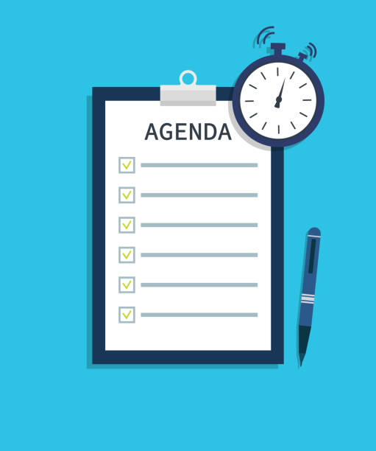
Agenda
SDLC
Object Oriented Design
Coding Principles (SOLID & CUPID)
Design Patterns
What is System Design ?
High Level v/s Low Level System Design
LLD Concepts
Resources

Slide 3
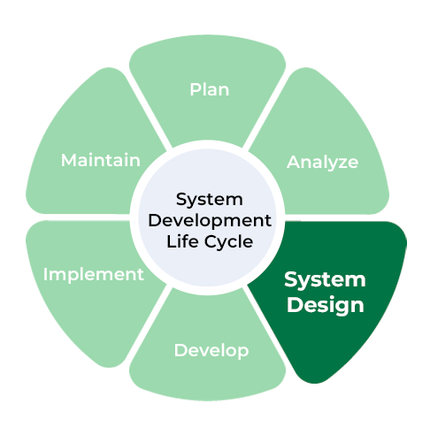
SDLC
Find a Problem / Get a Problem
Requirement Engineering
Design & Modelling
Development
Integration & Test
Implementation
Operations & Maintenance
Disposition

Slide 4
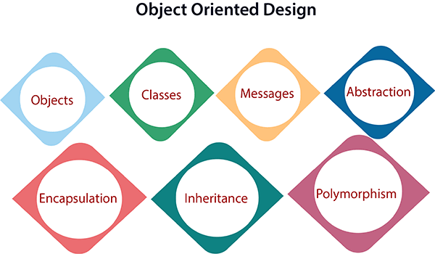
Object Oriented Design

Slide 5
SOLID Principles
S – Single Responsibility
O – Open-Closed
L – Liskov Substitution
I – Interface Segregation
D – Dependency Inversion

Slide 6
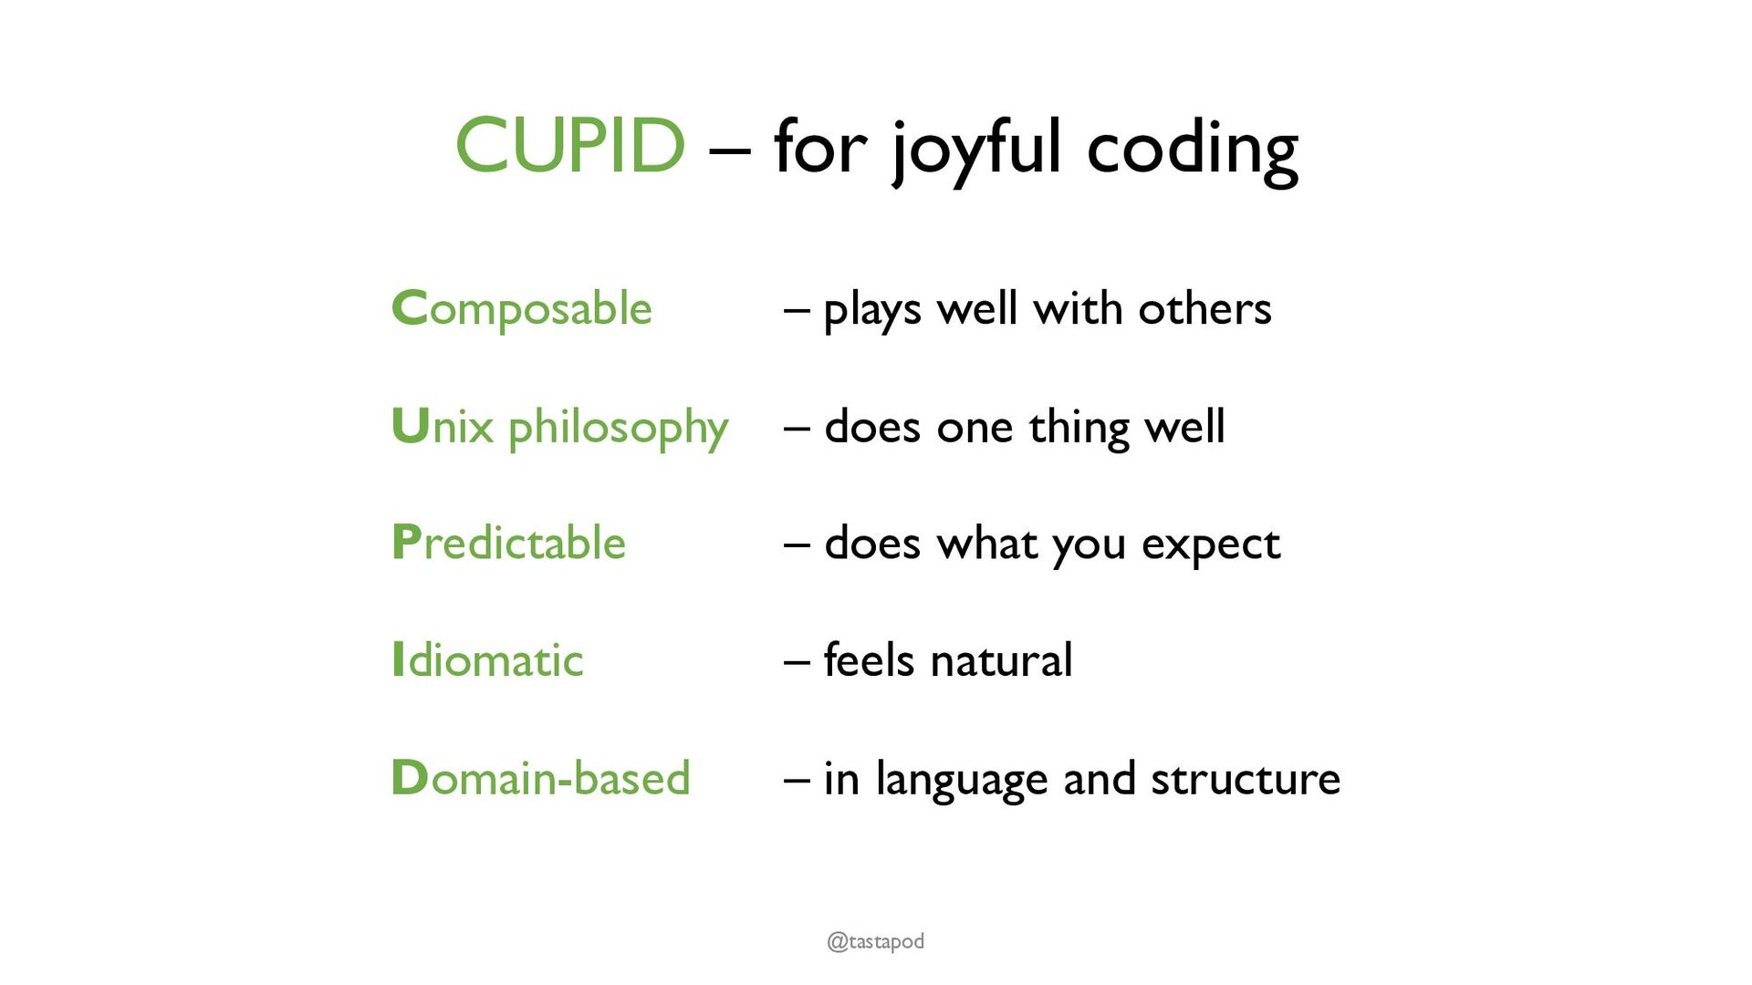

Slide 7
Design Patterns
See Design Patterns PPT in repo.
(Seminar to be held on Monday Nov 4, 2024, at 10 AM)

Slide 8
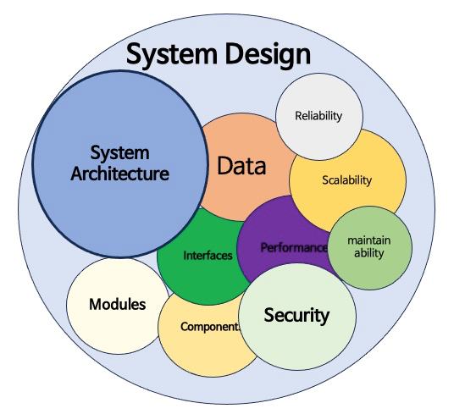
What is System Design ?
Software and Hardware Architecture
Structural and Behavioral

Slide 9
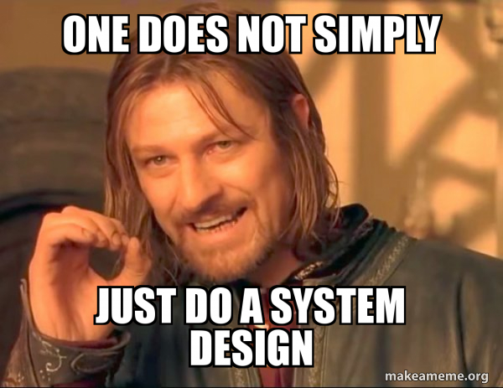

Slide 10
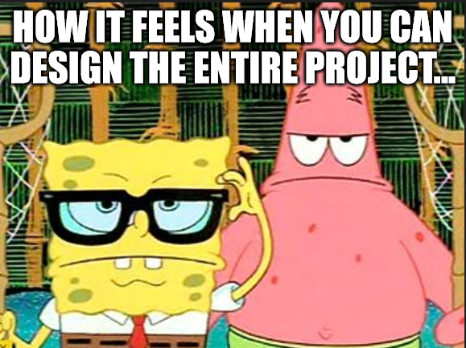

Slide 11
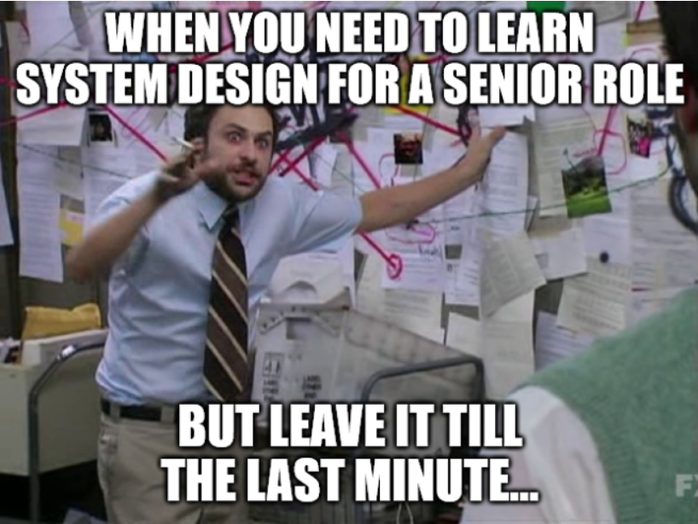

Slide 12
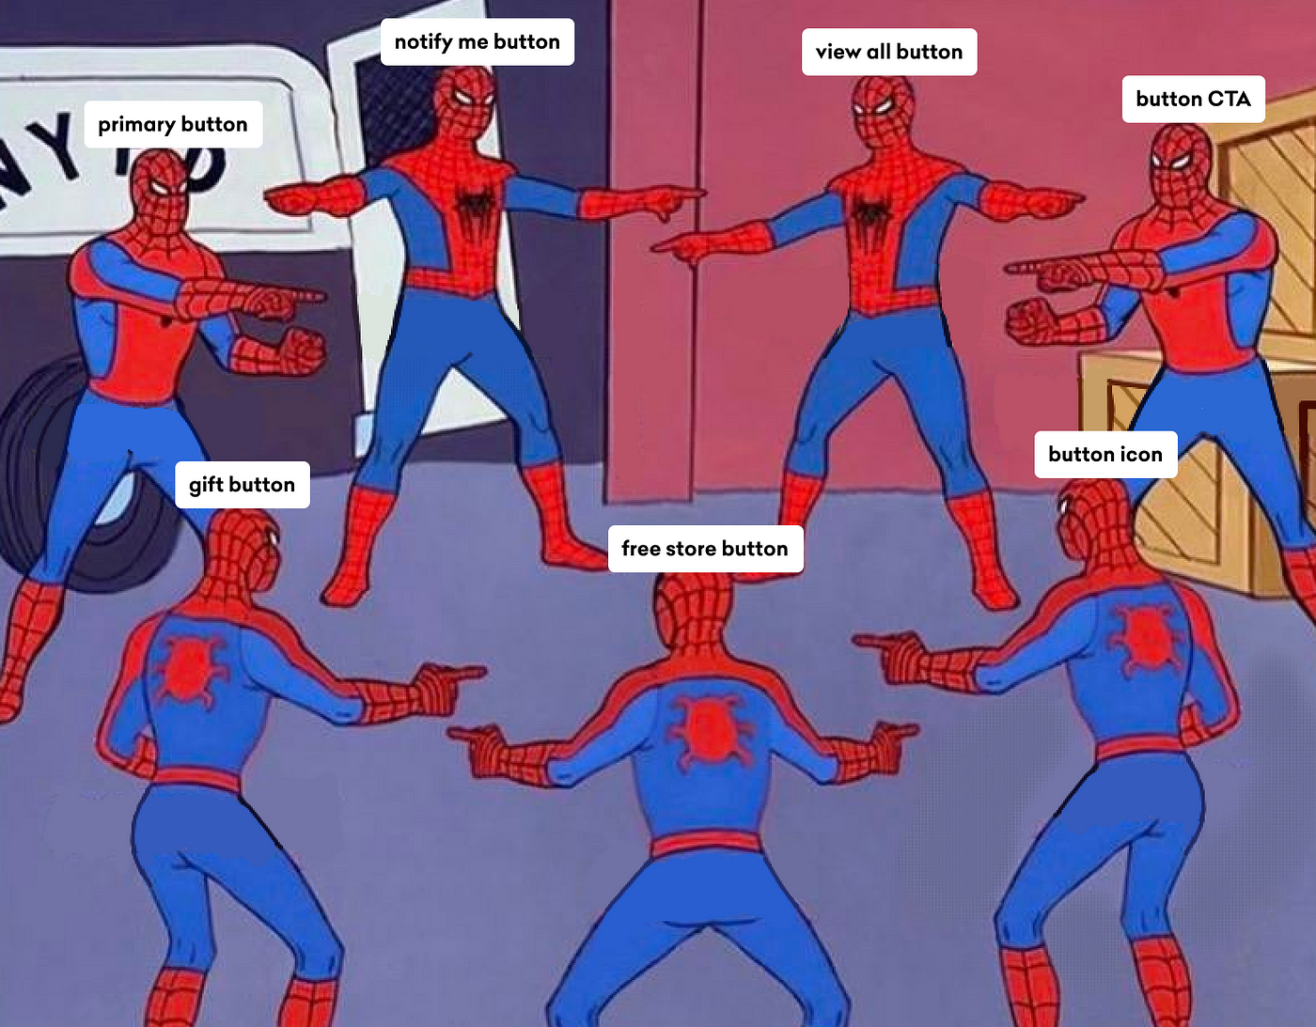

Slide 13


Slide 14
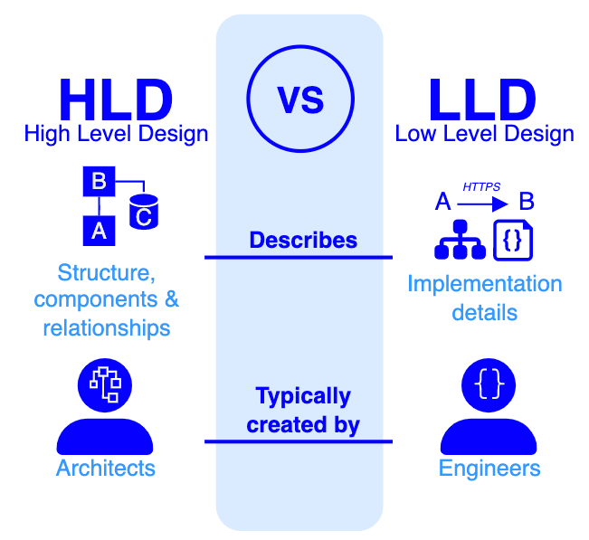
High Level V/s Low Level
High Level – Closer to Specification
Low Level – Closer to Implementation

Slide 15
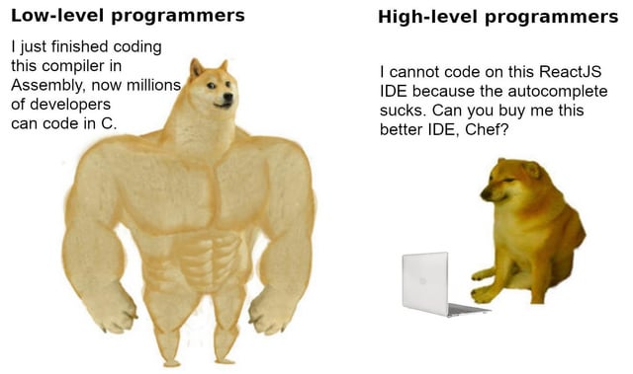

Slide 16
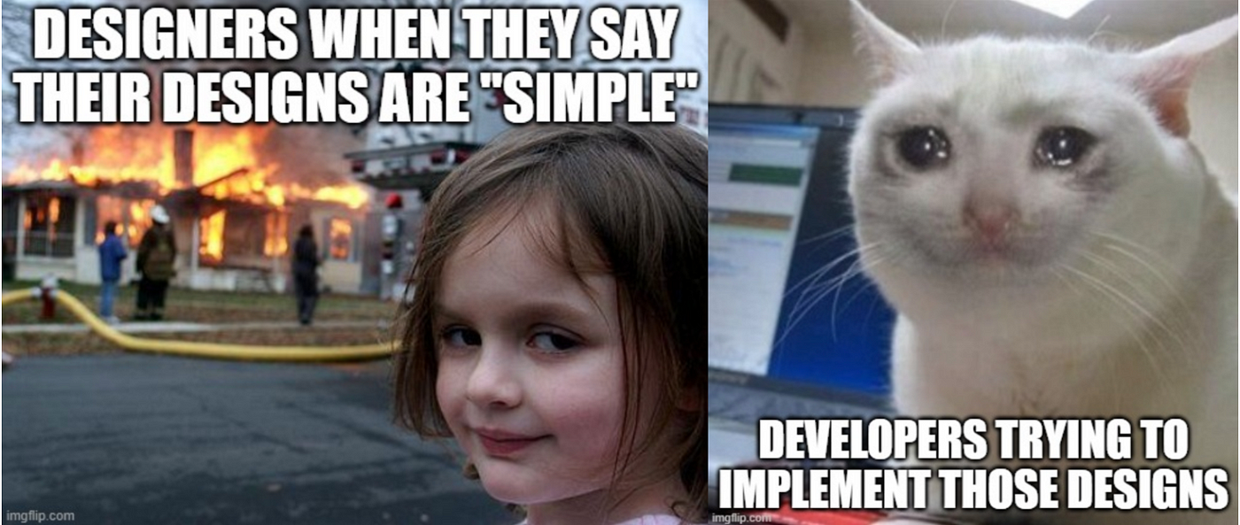

Slide 17
Low Level System Design Concepts
Scalability
Load Balancing
Caching
Database Design
Data Partitioning
Microservices
High Availability and Fault Tolerance
Security and Authentication
APIs (REST/GraphQL)
Latency and Throughput
Redundancy and Backup
Content Delivery Networks (CDNs)
API Gateways
Data Flow and Pipeline Design
Stateless vs. Stateful Systems
Concurrency and Parallelism
Monitoring and Logging

Slide 18
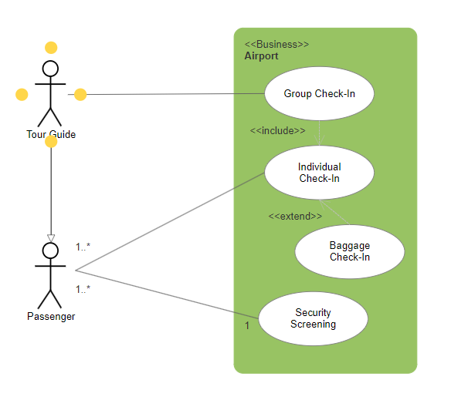
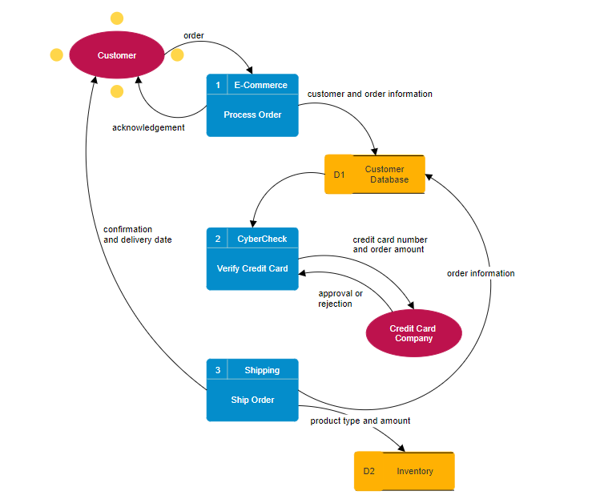
UML Diagrams
Use Case Diagram
Data Flow Diagram

Slide 19
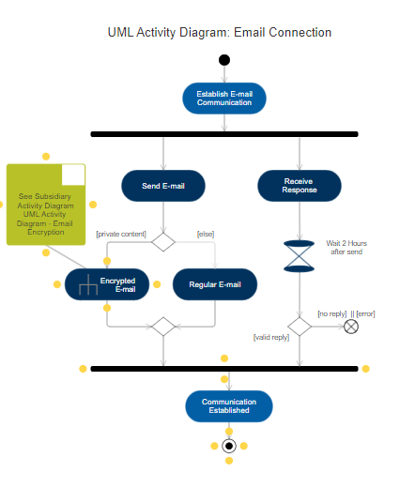
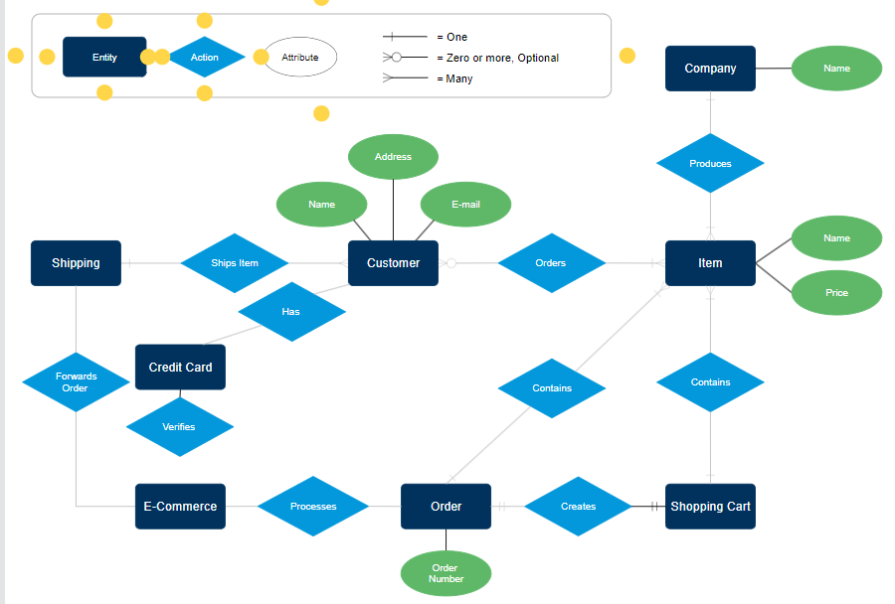
UML Diagrams
Activity Diagram
Entity Relationship Diagram

Slide 20
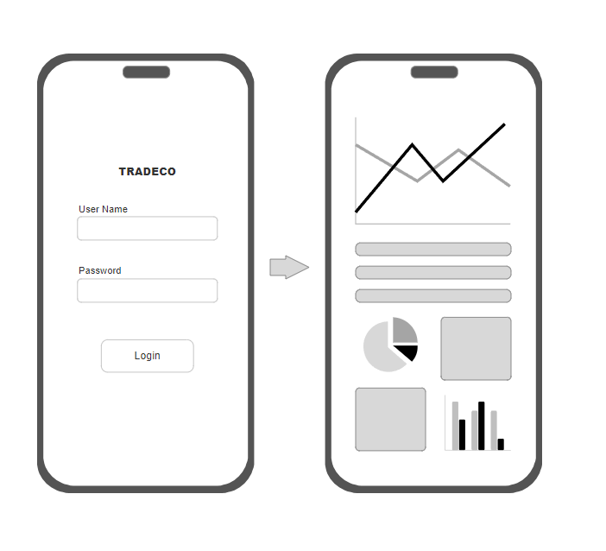
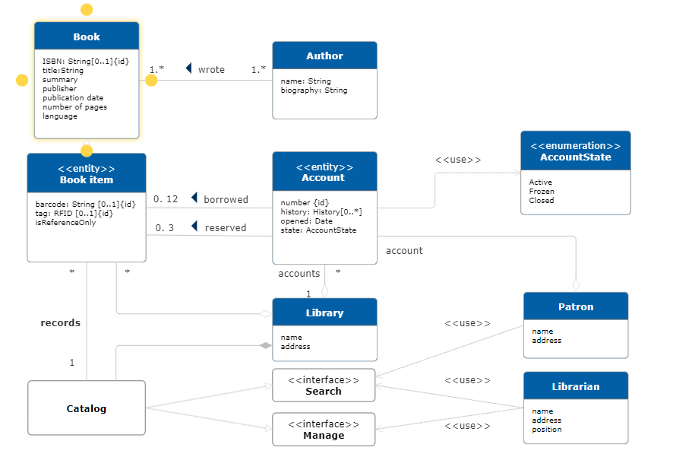
UML Diagrams
Wireframes
Class Diagram

Slide 21
Resources
https://github.com/donnemartin/system-design-primer
https://github.com/ashishps1/awesome-low-level-design
https://github.com/DovAmir/awesome-design-patterns
https://github.com/sindresorhus/awesome?tab=readme-ov-file
Do Projects !
Think about Ideas and make system design

Slide 22

Shameless Self Promotion - I

Slide 23

Shameless Self Promotion - II

Slide 24


Slide 25
Thanks!
Do you have any questions?
damlet@uwindsor.ca
Or Say Hi to Tanmay Damle On Teams

